Slide 1
Media - films and games
Maths in the workplace

Slide 2
How our teaching resources are designed for the classroom

Slide 3
I can understand how maths is used in the media industry.

Slide 4
Forced perspective is a technique that makes an object appear larger, smaller, farther or closer than it really is.

Slide 5

Media - films and games
Films
Games

Slide 6

Films
Here is a picture of some people enjoying a park. What do you notice?

Slide 7
Films
Lucas says: ‘The person sitting down must be taller than the person walking.’

Slide 8
Films
This is not necessarily true. The person walking is further away from the camera, so appears smaller.

Slide 9
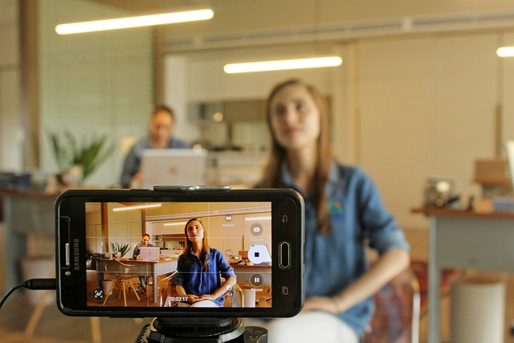

Films
One of these people is taller than the other.
True - we can see this.
False - they are the same height.
Maybe - there is not enough information.

Slide 10
Films
In order to ‘trick’ a person into seeing an object in a certain way, their perspective can be manipulated.
Forced perspective is a technique that makes an object appear larger, smaller, farther or closer than it really is.

Slide 11
Films
Forced perspective is very useful in film making, as it is a much cheaper alternative to CGI.
The Lord of the Rings films used forced perspective to make some certain actors seem much taller or shorter than the other actors.
The first thing we need to know is how much taller or shorter we want a person to be.

Slide 12
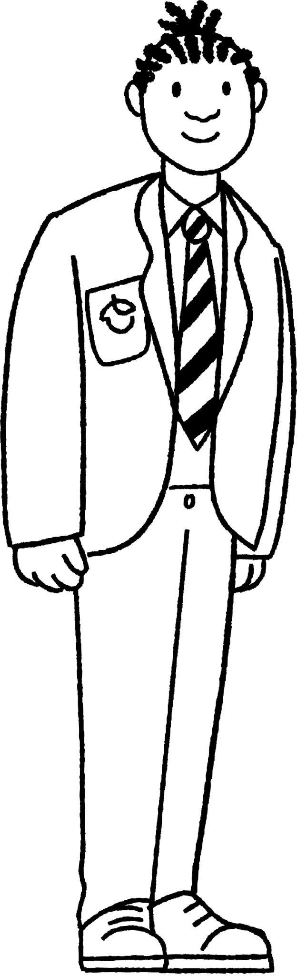
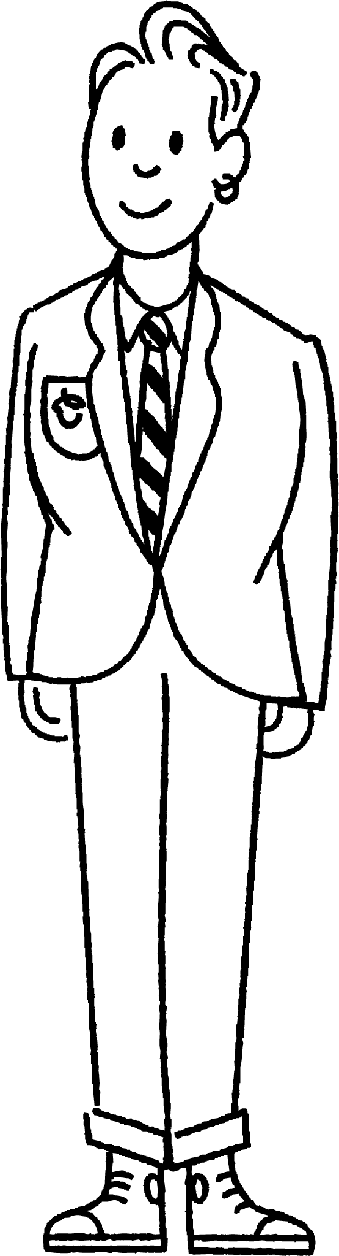
Films
Jacob and Sam are the same height. They want to record a video which makes it seem that Sam is two thirds of Jacob’s height.

Slide 13
Films
Jacob stands 2 m away from the camera.
2 m

Slide 14
Films
In order for Sam to appear to be two thirds of Jacob’s height, Sam needs to stand here.
2 m
What do you notice about the distances?
3 m

Slide 15

Films
In order for Sam to appear to be two thirds of Jacob’s height, Sam needs to stand here.
2 m
3 m

Slide 16

Films
In order for Sam to appear to be two thirds of Jacob’s height, Jacob must stand at a distance from the camera which is two thirds of Sam’s distance from the camera.
2 m
3 m

Slide 17
Films
Jacob and Sam are the same height. They want to record a video which makes it seem that Jacob is three quarters of Sam’s height.
If Jacob stands 12 m away from the camera, how far away from the camera should Sam be?

Slide 18
Films
Jacob and Sam are the same height. They want to record a video which makes it seem that Jacob is three quarters of Sam’s height.
If Jacob stands 12 m away from the camera, how far away from the camera should Sam be?
9 m
12 m

Slide 19
Films
1) Investigation time.
You will need:
two rulers (same size)
one tape measure

Slide 20
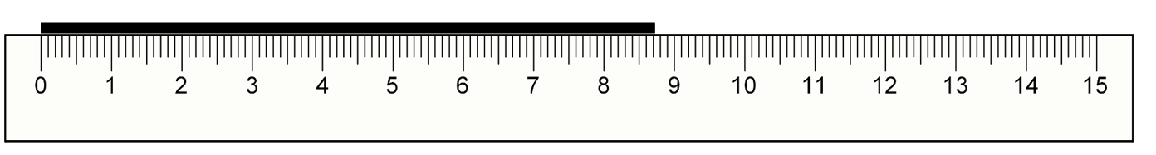
Films
1) Place your ruler on the shorter edge on a table (you may need to prop it against some books). Place the other ruler further away in the same orientation.

Slide 21
Films
1) Sit so that your eyes are level with top of the ‘smaller’ ruler. Use the ‘larger’ ruler to estimate how tall the ‘smaller’ ruler is.

Slide 22
Films
1) Now measure the distance between where you sat and each ruler using the tape measure.

Slide 23
Films
1) What is the relationship between the two distances and the perceived height of the ‘smaller’ ruler?
Repeat this investigation multiple times, placing the rulers at different points.
What do you notice?

Slide 24
Films
1) What is the relationship between the two distances and the perceived height of the ‘smaller’ ruler?
The ‘larger’ ruler was 10 cm away and the ‘smaller’ ruler was 15 cm away.
The ‘larger’ ruler was two thirds of the distance of the ‘smaller’ ruler.
The ‘smaller’ ruler was two thirds of the height of the ‘larger’ ruler.

Slide 25
Media - films and games
Films
Games

Slide 26

Games
Animated films and computer games are created using maths.
E.g. Describe how the hero can get to point B.
X B

Slide 27
Games
She goes there.
This is not a good answer as we have no idea of the path the hero took. Characters should move smoothly between points, not blink (unless that’s their superpower).
X B

Slide 28
Games
She moves to the right and then up.
This is better as we now have an idea of a path. However, with no distances, the hero might end up in the wrong place.
X B

Slide 29
Games
By placing the hero on a coordinate grid, the hero’s movement can be described in terms of its start and end position.
In other words, we are going to describe this movement as a translation.

Slide 30
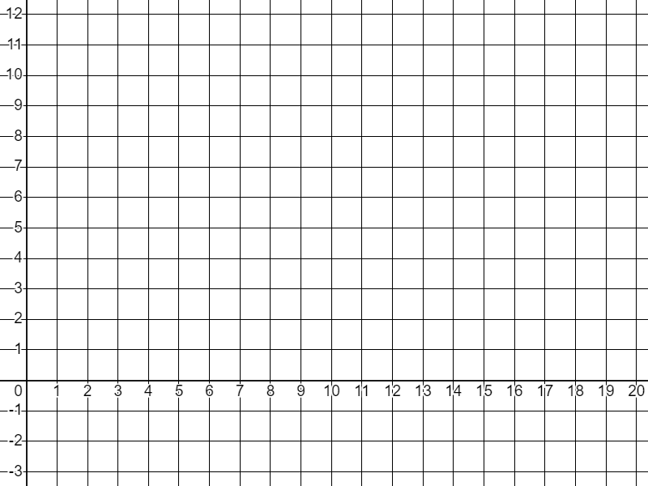
Games
The hero is placed on a grid with the x and y axes drawn.
A corner of the image is marked.

Slide 31
Games
Now it is possible to describe the movement of the hero to any given point.

Slide 32
Games
Describe the movement of the hero from her starting point to point:
a) (8, 2)
b) (4, 8)
c) (9, 6)
d) (10, -1)

Slide 33
Games
Describe the movement of the hero from her starting point to point:
a) (8, 2)
Translation of 4 units right.

Slide 34
Games
Describe the movement of the hero from her starting point to point:
b) (4, 8)
Translation of 6 units up.

Slide 35
Games
Describe the movement of the hero from her starting point to point:
c) (9, 6)
Translation of 5 units right and 4 units up.

Slide 36
Games
Describe the movement of the hero from her starting point to point:
d) (10, -1)
Translation of 6 units right and 3 units down.

Slide 37
Games
Animators use transformations in order to manipulate the characters in animated films and games.
Translation moves a character.
Enlargement changes their size (as the character moves closer to the screen or farther away).
Rotation allows a character to turn.

Slide 38
Games
Objective - reach the goal in 3 turns.
You are player A.
Write down the translation required to get to the goal.
If you would move to the same space as the computer, you end your movement (unless you reach the goal). Movement is in one unit increments.
You must make it past the computer and to the goal in 3 turns or less.

Slide 39
Games
Example: = Goal
A
Player A
5 units down
2 units left
A
Computer (B)
4 units left
3 units down
A
B
B
B
Since they collided, movement stops. Player A must now come up with a new translation to reach the goal.

Slide 40
Games
Example: = Goal
Player A
4 units down
2 units left
A
Computer (B)
4 units down
3 units left
A
B
A
B
A
B
A
A
A
B
B
B
B
B
Player A has reached the goal and beaten the computer!

Slide 41
Games
1) = Goal
A
Player A
Computer (B)
Round 1: 4 units left
Round 2: 1 unit right, 1 unit down
Round 3: 2 units up
B

Slide 42
Games
2) = Goal
Player A
Computer (B)
Round 1: 2 units left, 1 unit up
Round 2: 1 unit left
Round 3: 1 unit up, 2 units right
A
B

Slide 43
Games
3) Design your own game. Decide where A and B will start and where the goal will be. Write your instructions for the computer. Swap with a peer and see if you can beat each other’s game.

Slide 44
Games
1) = Goal
A
Player A
E.g.
Round 1: 1 unit left, 5 units down
Round 2: 1 unit right
Computer (B)
Round 1: 4 units left
Round 2: 1 unit right, 1 unit down
Round 3: 2 units up
B

Slide 45
Games
2) = Goal
Player A
E.g.
Round 1: 1 unit up, 6 units right
Round 2: 1 unit down
Computer (B)
Round 1: 2 units left, 1 unit up
Round 2: 1 unit left
Round 3: 1 unit up, 2 units right
A
B

Slide 46
Games
3) Design your own game. Decide where A and B will start and where the goal will be. Write your instructions for the computer. Swap with a peer and see if you can beat each other’s game.
You could modify the game by allowing more complicated rules should you wish.

Slide 47
Media - films and games
Forced perspective is a technique that makes an object appear larger, smaller, farther or closer than it really is.
Scaling is used to achieve this.
Transformations are used by animators to describe character movement in films and games.

Slide 48

© Oak National Academy 2024.
Produced in partnership with Mathematics in Education and Industry
Licensed on the Open Government Licence v3.0, except where otherwise stated. See Oak terms and conditions.

